Slide 1
Data pre-processing
Data pre-processing is a process of preparing the raw data and making it suitable for a machine learning model. It is the first and crucial step while creating a machine learning model.

Slide 2
Why do we need Data Pre-processing?
A real-world data generally contains noises, missing values, and maybe in an unusable format which cannot be directly used for machine learning models. Data pre-processing is required tasks for cleaning the data and making it suitable for a machine learning model which also increases the accuracy and efficiency of a machine learning model

Slide 3
It involves below steps:
1. Collection of data in a Dataset
2. Importing libraries
3. Importing datasets
4. Finding Missing Data
5. Encoding Categorical Data
6. Splitting dataset into training and test set
7. Feature scaling

Slide 4
Collection of data in a Dataset
The first thing we required is a dataset as a machine learning model
completely works on data. The collected data for a particular problem in a proper format is known as the dataset. To use the dataset in our code, we usually put it into a CSV file.

Slide 5
Data set
A Dataset is a set or collection of data. This set is normally presented in a tabular pattern. Every column describes a particular variable. And each row corresponds to a given member of the data set.

Slide 6
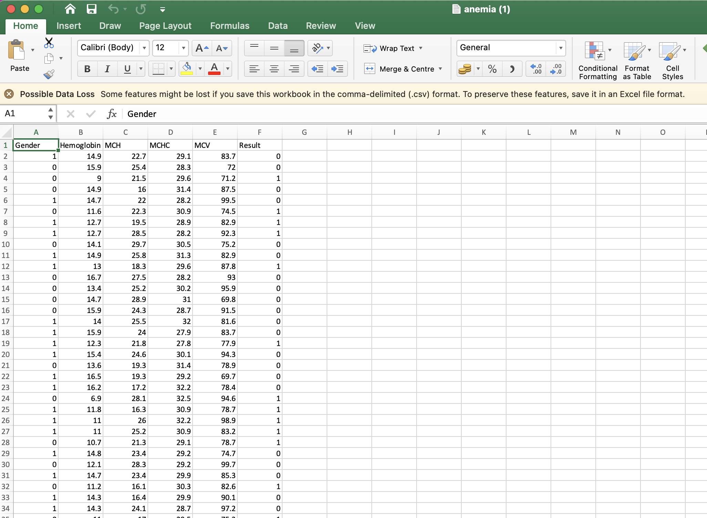
Anemia.csv dataset file

Slide 7
2. Importing libraries:
(a) Numpy: Numpy Python library is used for including any type of mathematical operation in the code. It is the fundamental package for scientific calculation in Python. It also supports to add large, multidimensional arrays and matrices. So, in Python, we can import it as:
import numpy as np

Slide 8
(b) Matplotlib: The second library is matplotlib, which is a Python 2D plotting library, and with this library, we need to import a sub-library pyplot. This library is used to plot any type of charts in Python for the code. It will be imported as below:
import matplotlib.pyplot as mpt
Here we have used mpt as a short name for this library.

Slide 9
Pandas: The last library is the Pandas library, which is one of the most famous Python libraries and used for importing and managing the datasets. It is an open-source data manipulation and analysis library. It will be imported as below:
import pandas as pd
Here, we have used pd as a short name for this library.

Slide 10
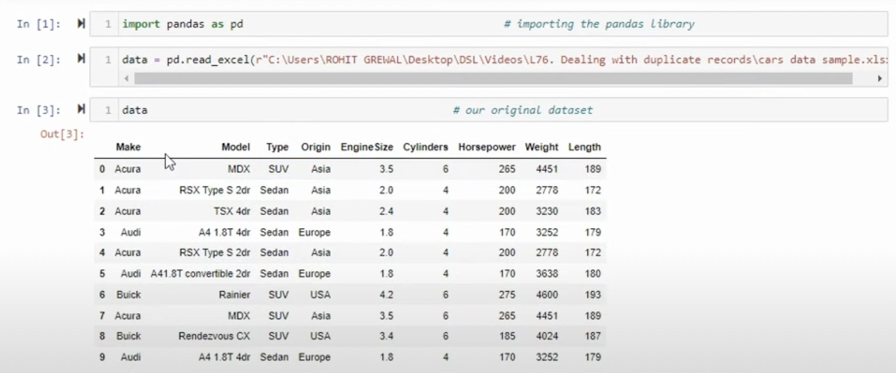
3. Importing datasets:

Slide 11
Data Frame
A Data Frame is a data structure that organizes data into a 2-dimensional table of rows and columns, much like a spreadsheet.

Slide 12
Extracting Independent and Dependent Variables:
In machine learning, it is important to distinguish the matrix of features (independent variables) and dependent variables from dataset.
For Eg: In our dataset, there are three independent variables that are Country, Age and Salary, and one is a dependent variable which is purchased.

Slide 13
Extracting Independent Variables: To extract an independent variable, we will use
iloc [ ] method of Pandas library. It is used to extract the required rows and columns from the dataset.
For Eg: x= data_set. iloc [:,:-1].values
In the above code, the first colon (:) is used to take all the rows, and the second colon (:) is for all the columns. Here we have used (:-1), because we don't want to take the last column as it contains the dependent variable. So by doing this, we will get the matrix of features.
Extracting dependent Variables: To extract dependent variables, again, we will use
Pandas .iloc[] method.
For Eg: y= data_set. iloc [:, 3].values
Here we have taken all the rows with the last column only. It will give the array of dependent variables.

Slide 14
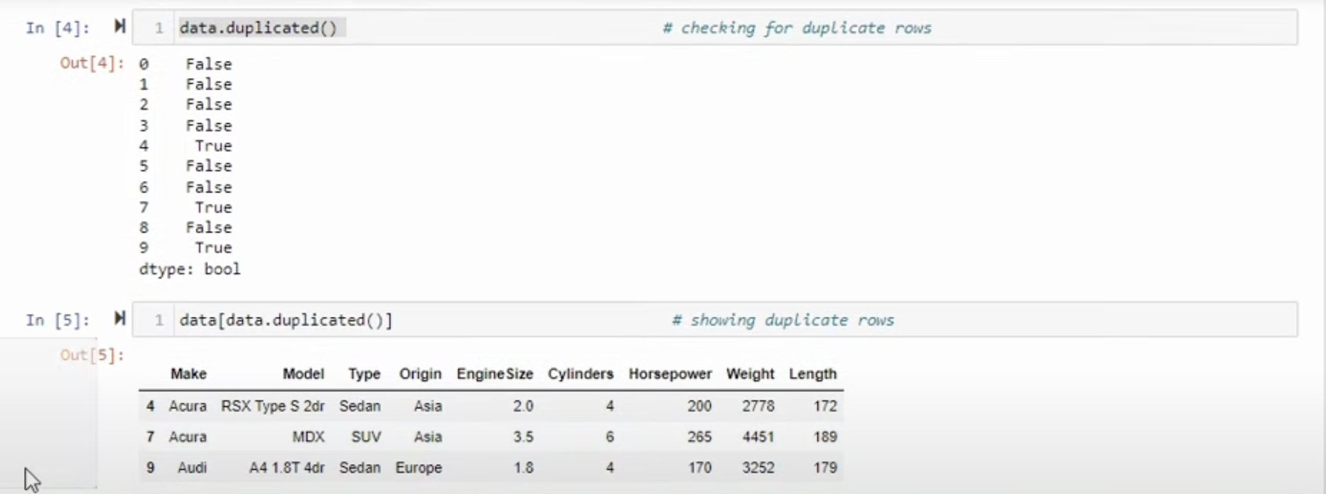
Identification of Duplicate records

Slide 15
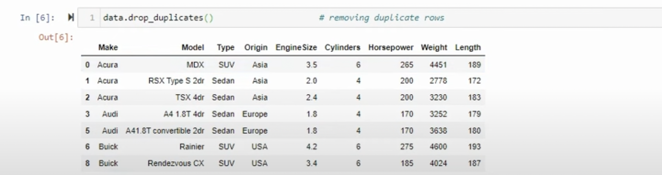
Removal of duplicate rows

Slide 16
Finding Missing Data
Mean, Median, or Mode Imputation:
Replace missing values with the mean, median, or mode of the respective column. This is suitable for numerical features.
# Assuming 'df' is your DataFrame
df.fillna(df.mean(), inplace=True) # Use df.median() or df.mode().iloc[0] for median or mode

Slide 17
Forward Fill or Backward Fill:
Propagate the last known value forward or the next known value backward.
df.fillna(method='ffill', inplace=True) # Forward fill
# Or
df.fillna(method='bfill', inplace=True) # Backward fill

Slide 18
Interpolation:
Interpolate missing values based on the values around them. This is useful for time series data or data with a natural order.
df.interpolate(method='linear', inplace=True)

Slide 19
Interpolation:
Interpolate missing values based on the values around them. This is useful for time series data or data with a natural order.
df.fillna(value=0, inplace=True) # Replace with 0; you can use any constant

Slide 20
Constant Value Imputation:
Replace missing values with a constant value.
df.fillna(value=0, inplace=True) # Replace with 0; you can use any constant

Slide 21
Remove Rows or Columns:
If the number of missing values is small, you might consider removing the corresponding rows or columns.
df.dropna(axis=0, inplace=True) # Remove rows with missing values
# Or
df.dropna(axis=1, inplace=True) # Remove columns with missing values

Slide 22
Machine Learning Imputation:
Use machine learning algorithms to predict missing values based on other features in your dataset. This is more complex but can be effective.
from sklearn.impute import KNNImputer
imputer = KNNImputer(n_neighbors=2)
df_filled = imputer.fit_transform(df)

Slide 23
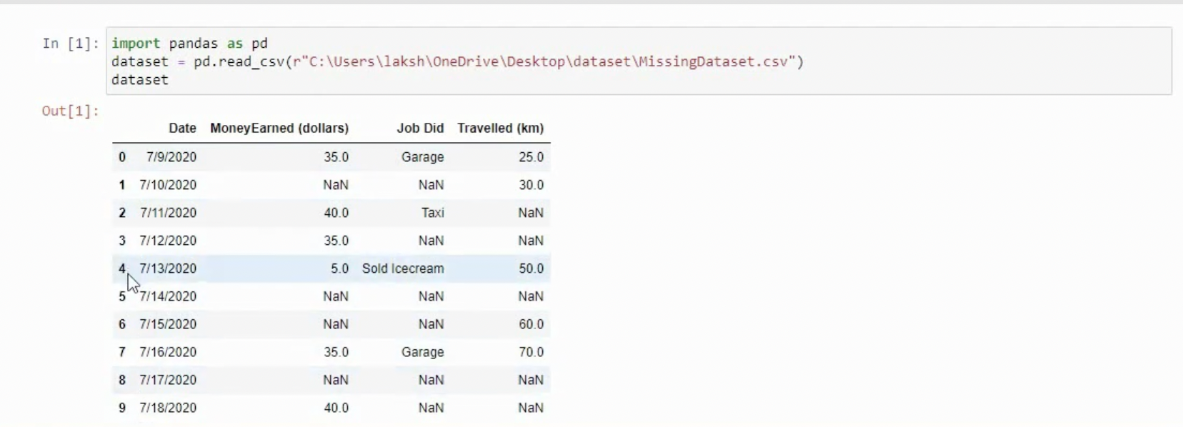
Finding missing values

Slide 24
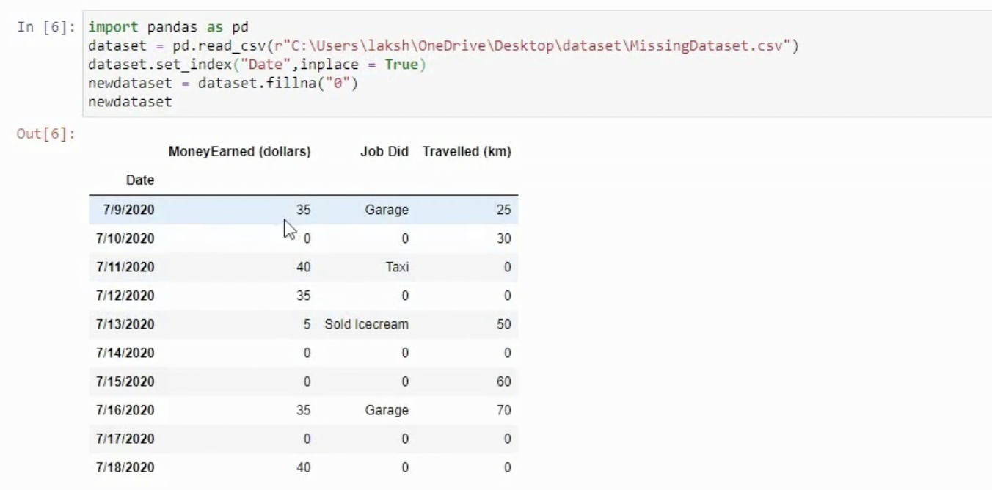
Filling missing values with ’0’

Slide 25
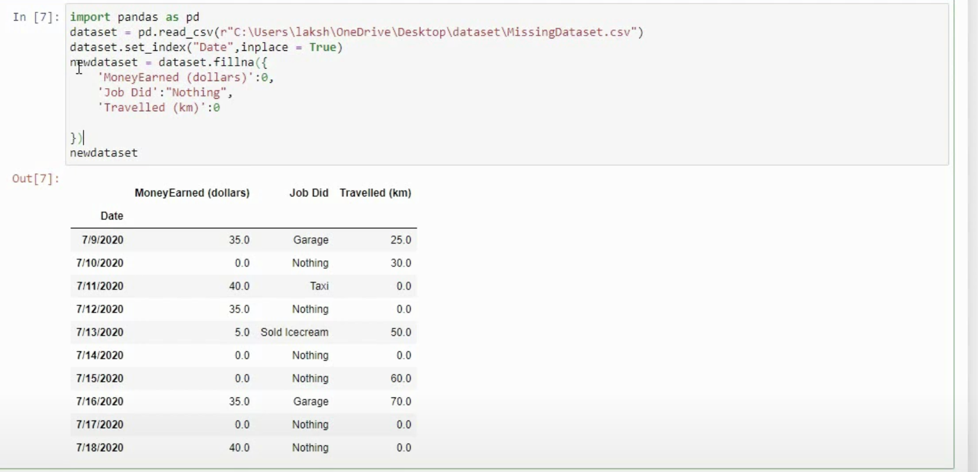
Filling missing values with some data

Slide 26
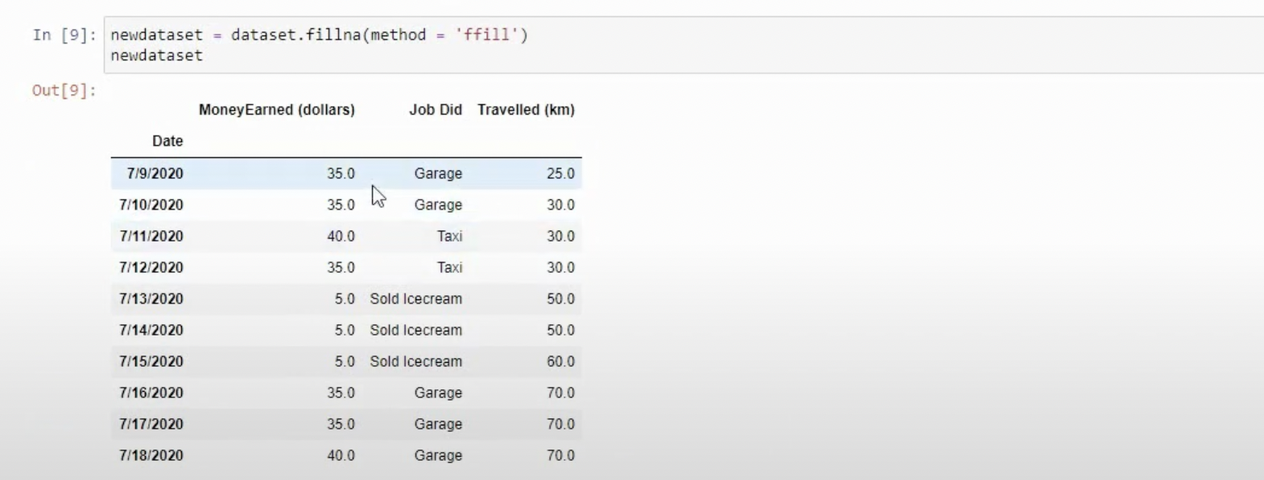
Filling missing values with ‘forward data’

Slide 27
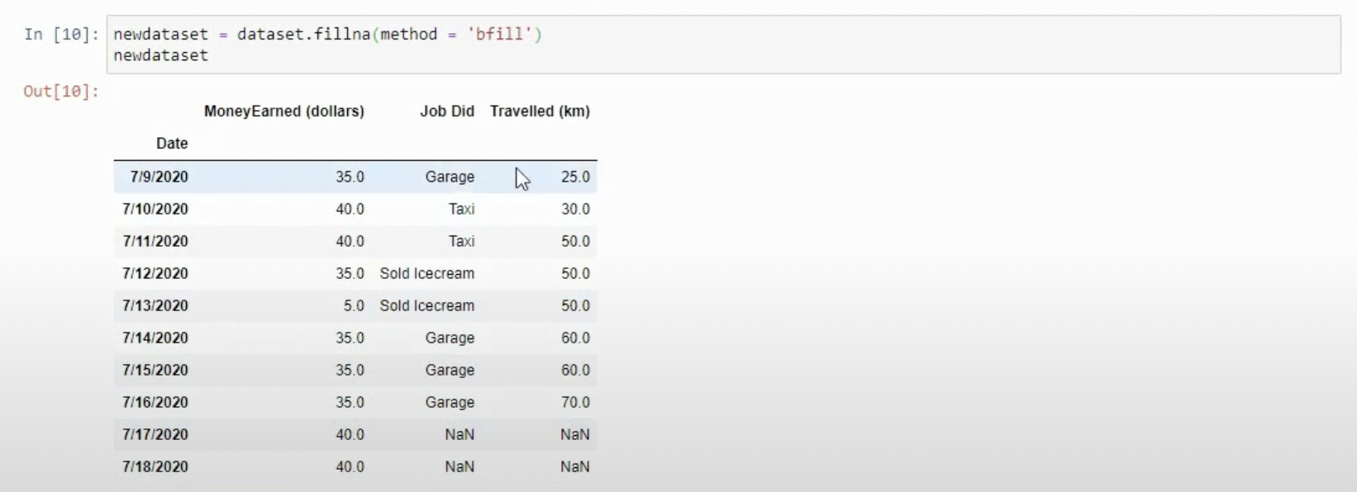
Filling missing values with ‘backward data’

Slide 28
5. Encoding Categorical Data: Since machine learning model completely works on mathematics and numbers, but if our dataset would have a categorical variable, then it may create trouble while building the model. So it is necessary to encode these categorical variables into numbers.

Slide 29
The ColumnTransformer in scikit-learn allows you to apply different transformations to different subsets of columns in your dataset. This is particularly useful when you have a mix of numerical and categorical columns, and if wewant to apply different preprocessing steps to each type.

Slide 30
Feature Scaling: Feature scaling is the final step of data pre-processing in machine learning. It is a technique to standardize the independent variables of the dataset in a specific range. In feature scaling, we put in the same range and in the same scale so that no any variable dominate the other variable.

Slide 31
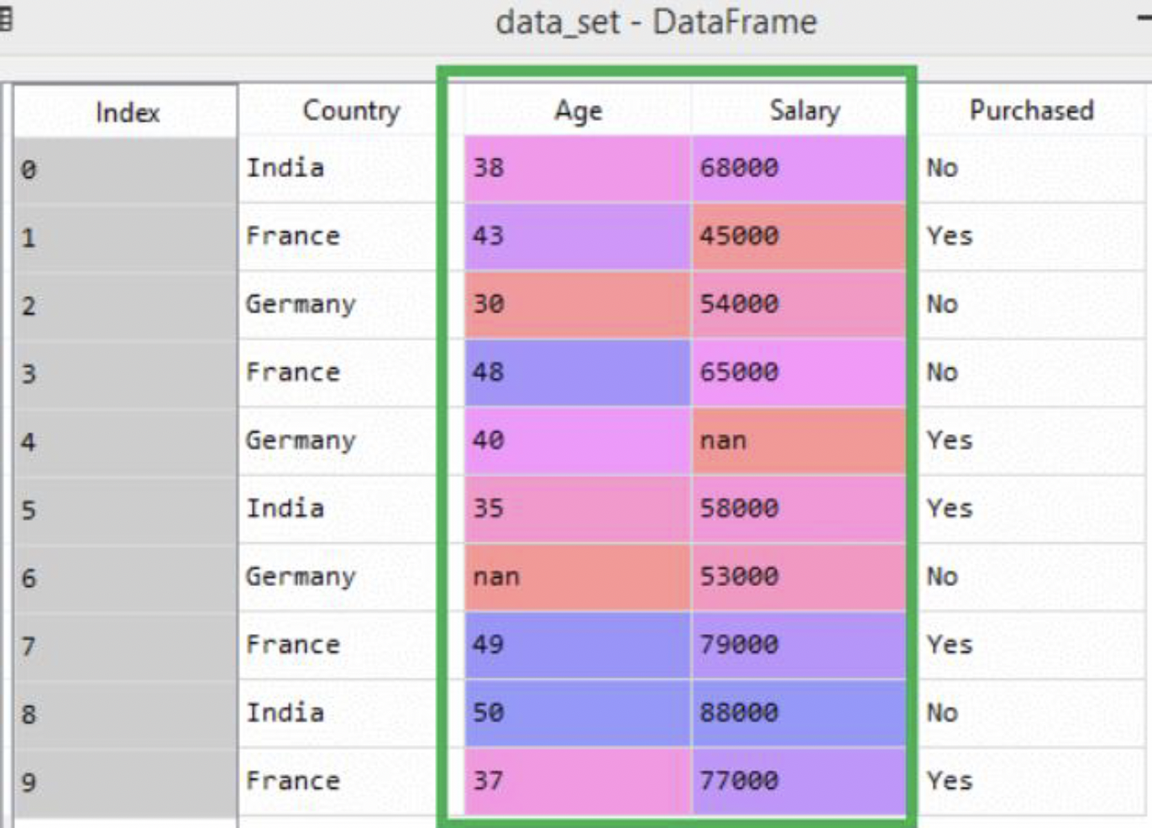

Slide 32
As we can see, the age and salary column values are not on the same scale. A machine learning model is based on Euclidean distance, and if we do not scale the variable, then it will cause some issue in our machine learning model.
If we compute any two values from age and salary, then salary values will dominate the age values, and it will produce an incorrect result. So to remove this issue, we need to perform feature scaling for machine learning.

Slide 33
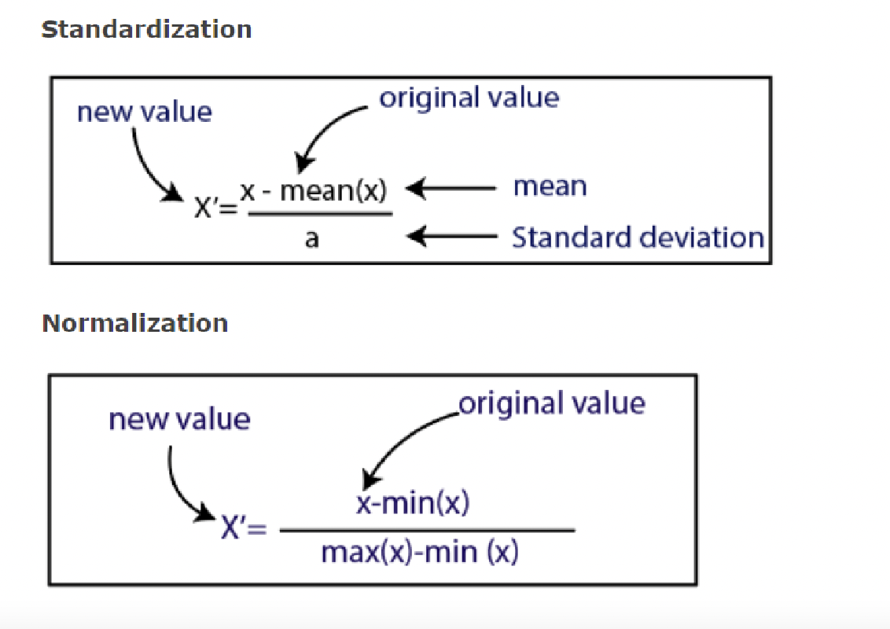

Slide 34
For feature scaling, we will import StandardScaler class of sklearn.preprocessing library as:
from sklearn.preprocessing import StandardScaler
Now, we will create the object of StandardScaler class for independent variables or features. And then we will fit and transform the training dataset.
st_x= StandardScaler ()
x_train= st_x.fit_transform(x_train)

Slide 35
Data visualization
Data visualization in Python is commonly done using libraries like Matplotlib and Seaborn.

Slide 36
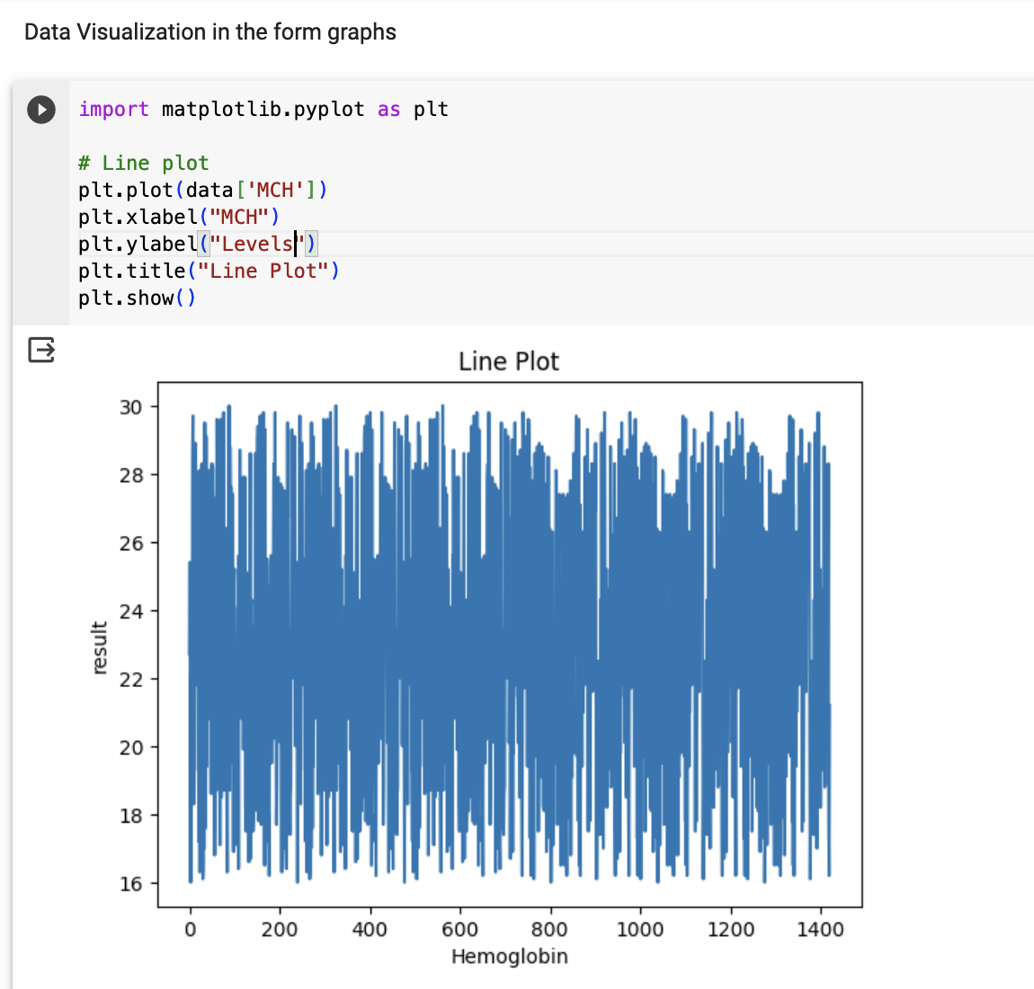

Slide 37
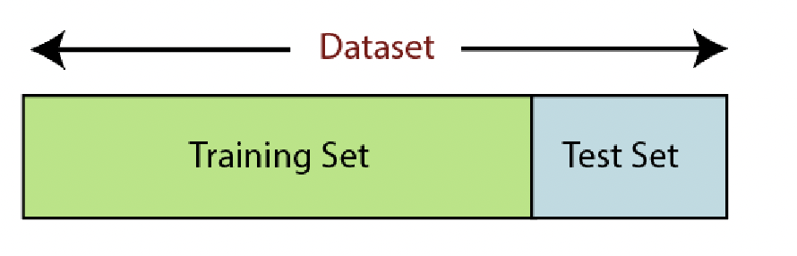
6. Splitting dataset into training and test set: we divide our dataset into a training set and test set.
For splitting the dataset, we will use the below lines of code:
from sklearn.model_selection import train_test_split
x_train, x_test, y_train, y_test= train_test_split(x, y, test_size= 0.2, random_state=0)

Slide 38
x_train: features for the training data
x_test: features for testing data
y_train: Dependent variables for training data
y_test: dependent variable for testing data

